Slide 1
Testing Your Code
Why and how

Slide 2
Learning Objectives
Understanding the importance of testing code.
Gaining a familiarity with some of the methods used to test code.
Learning how to use the Assert keyword in Python

Slide 3
What is testing?
Testing is the process of evaluating a system or its components, with the intent to find whether it satisfies the specific requirements or not.
In other words – does our code work as intended? Are there any bugs or issues that could arise?
We test by executing our software with the intent of finding any defects.

Slide 4
Why test our code?
Testing helps catch errors early in development.
Writing tests encourages better code design, often making it more modular, readable, and maintainable.
Tests can act as documentation for your code, clearly demonstrating how different parts of the code should behave.

Slide 5
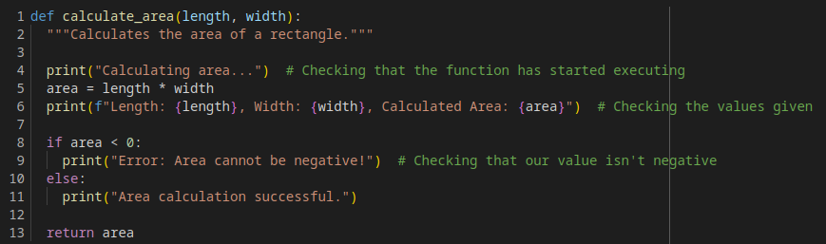
How I used to test my code
Filling code blocks with print statements can help, but there is a better way...

Slide 6
Assert Keyword in Python
The Python assert keyword allows you to write tests, known as assertions, in your code.
Assertions test if certain assumptions remain true while you're developing your code.
If any of your assertions return false, during development, it suggest that you have a bug in your code.

Slide 7
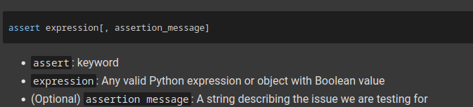

The Syntax of assert

Slide 8
When to use Assertions?
When developing/debugging code, it is considered good practice to:
Write the tests you want your code to pass.
Check that the tests pass.
Fix the code until it passes.
When documenting code:
Assertions can help alert developers to a potential bug.
Assertions can be more effective than comments, as the code will terminate if a test condition is violated.

Slide 9
Common Assertion Formats
There are a few different assertion expressions:
Comparison: For checking the relationships between values.
Membership: Verifying if an item exists in a collection.
Type-check: Ensure a variable is of the expected data type.

Slide 10

Comparison Assertions
These assertions use comparison operators to check the relationship between values.
For example:

Slide 11
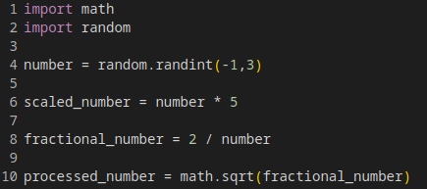
The following code has some possible issues. What assertion tests can help us find them?
Question 1
Menti Code: 3516 5462

Slide 12
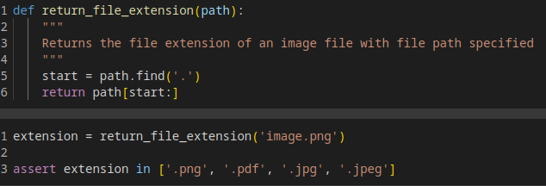
Membership Assertions
This assertion tests whether something is a member of a collection.
For example:

Slide 13
What would a sensible assertion test be for the following code description?
I am running a small fruit delivery company that stocks the following items:
Apples
Oranges
Watermelons
Lemons
Customers add their chosen item to their cart before paying. I am currently out of stock of lemons. What test can I use to make sure people don't check out with lemons in their cart?
Question 2
Menti Code: 3516 5462

Slide 14
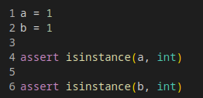
Type-Check Assertions
These assertions test whether an object is an instance of a certain class or type.
For example:

Slide 15
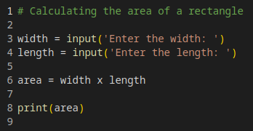
What would a sensible assertion test be for the following?
Question 3
Menti Code: 3516 5462

Slide 16

Assert All
Assert all checks if all conditions in an iterable are true.
If all values pass the test, then the test passes.
For example:

Slide 17

Assert Any
Assert any checks if any of the values pass the test.
If any value passes, then the test passes.
For example:

Slide 18
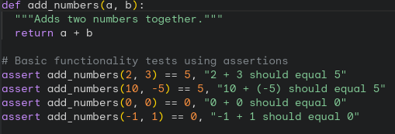
Assertions can help as a sanity check
I'm sure we've all found ourselves in a situation where code that should be working isn't. Maybe a simple function has an unexpected output, or a simple addition isn't adding up.
Sometimes you just need to prove to yourself that you haven't gone mad!

Slide 19
What are some potential issues with the following? What assertions can we use to test?
I have a python script that I use to calculate student grade classifications. It takes an input of their results, calculates their average, and then outputs their grade classification.
The classifications are as follows:
80+ : A
70-80 : B
60-70 : C
50-60 : D
0-49 : Fail
Question 4
Menti Code: 3516 5462

Slide 20
Which assertion tests would be most appropriate for the following?
I've asked for the user to enter two numbers that are added together, but sometimes I get an error?
Users on my app are required to enter their email address. A valid email address needs to contain both an @ and a .com. How do I test this?
I want to check that a user's password meets all the following criteria – 8 characters long, contains at least one uppercase and one lowercase letter, and contains a special character from this list {!, @, $, *}.
Question 5
Menti Code: 3516 5462

Slide 21
Some final thoughts on assertions
Assertions are very helpful in catching potential errors early in your code.
If it helps make your code cleaner, you can use a backslash to split your assertion over several lines.
If using multiple assertions, the program will terminate at the first assertion that fails.

Slide 22
Some things to keep in mind...
Testing can often be subjective.
For example, what one person finds user-friendly may not be for someone else.
Assertions are just the start!
There are plenty of formalised testing paradigms for you to engage with.
Testing will form a part of your assessments, and we will expect them to be precise!

Slide 23
Test Driven Development
Test-driven development is a software development approach where you write tests before you write the code.
TDD typically follows a cycle that looks like this:
Write a test that initially fails. (Because the code doesn't exist yet!)
Write the minimum amount of code required to pass the test.
Refactor your code while ensuring that the tests still pass.
The benefits of TDD:
Fewer bugs
Better design
Increased confidence in making any changes.

Slide 24
Frameworks and Test Types
There are of course more detailed testing methodologies beyond simple assertions...
Unit tests are low level tests that test individual units or components of your code in isolation of the rest of the code
Integration tests are used to test whether multiple components are working together as intended.
System tests are designed to test the entire system as a whole.
There are plenty of testing frameworks available to help automate this process, such as unittest and pytest.

